Slide 1
Getting Started with Data Science in R: Statistics and Visualization Deva O’Neil Sept, 2023

Slide 2
Project analysis slide 2
A few things that
can be done with
Data Science
Modeling
Summary Statistics
Data
Visualization
Artificial Intelligence
Hypothesis Testing
Machine Learning

Slide 3
Project analysis slide 4
Fall 2023 Plan Data Science Workshops
Intro to Data Science
Tasks
.
Visualization and Statistics
Modeling, Regression
Hypothesis Testing
August.
…
Intro to Data Frames in RStudio
Sept..
October.
November.
Resources

Slide 4
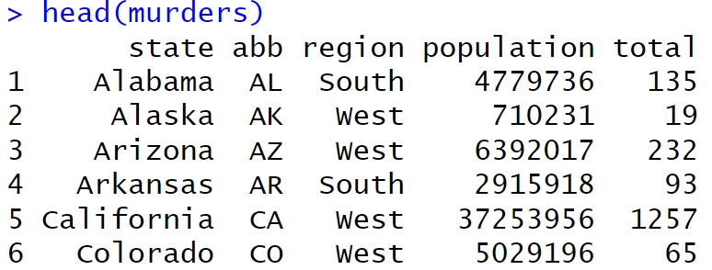
Project analysis slide 11
Statistics - dataframe

Slide 5

Project analysis slide 11
Average population

Slide 6
Project analysis slide 11
Average population

Slide 7
Project analysis slide 11
Average population
How would you modify this to give the average number of murders in western states?

Slide 8
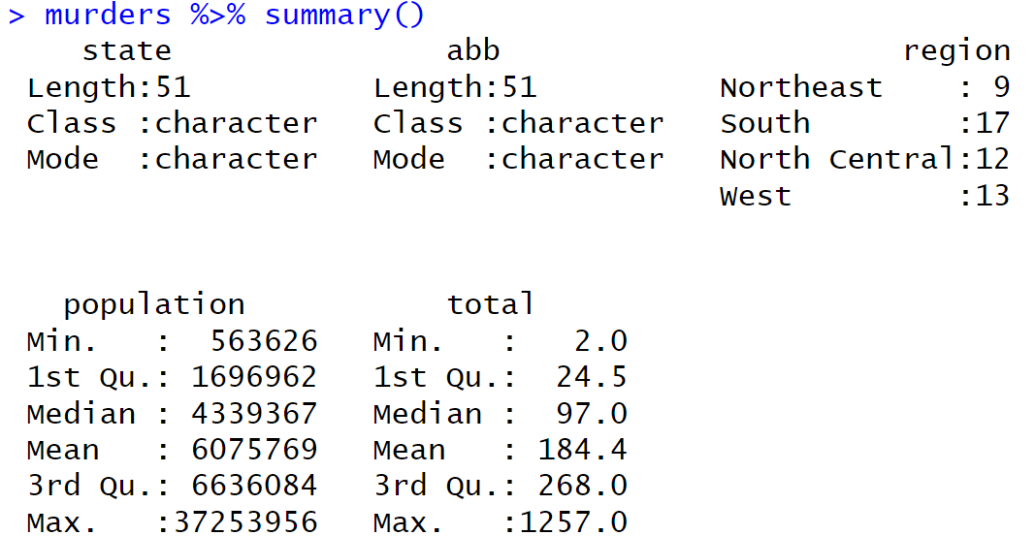
Project analysis slide 11
Average population

Slide 9
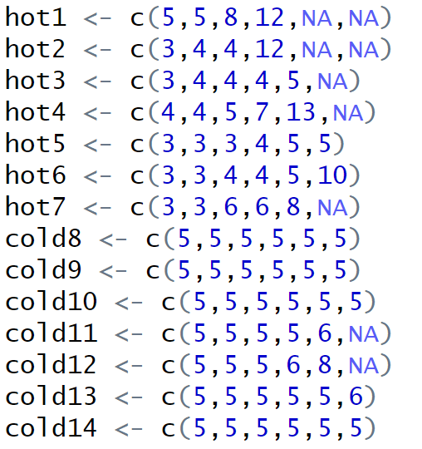
Project analysis slide 11
Visualization
Experiment:
Lettuce Germination
Days to germination
For each 6-pack
NA = not available
(failed to germinate)

Slide 10
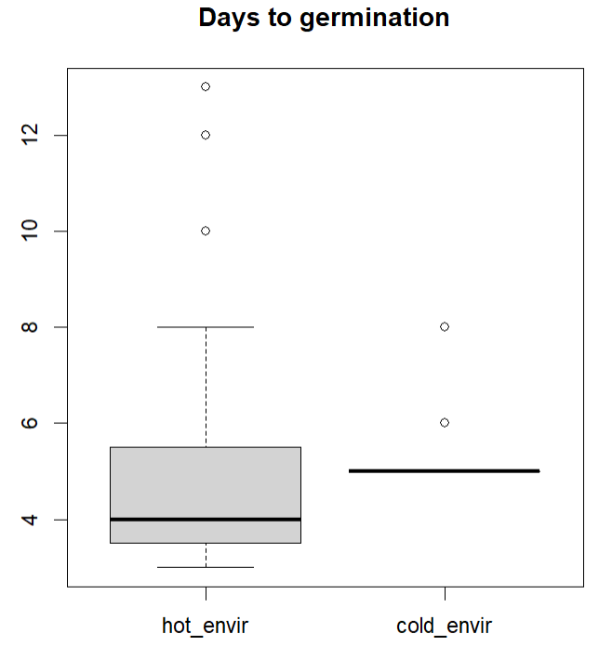
Project analysis slide 11
Visualization
Boxplot:
Lettuce Germination

Slide 11
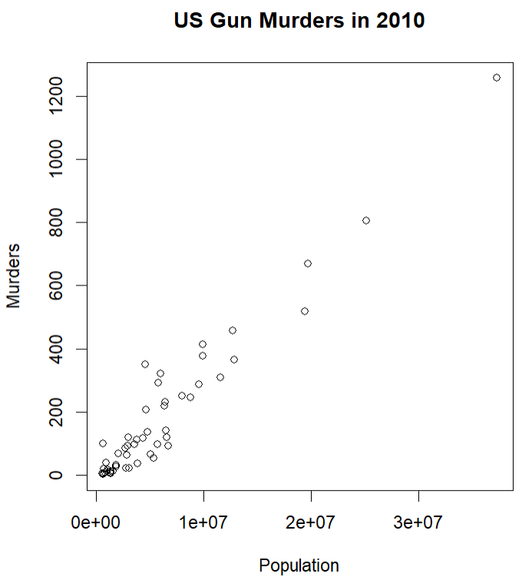
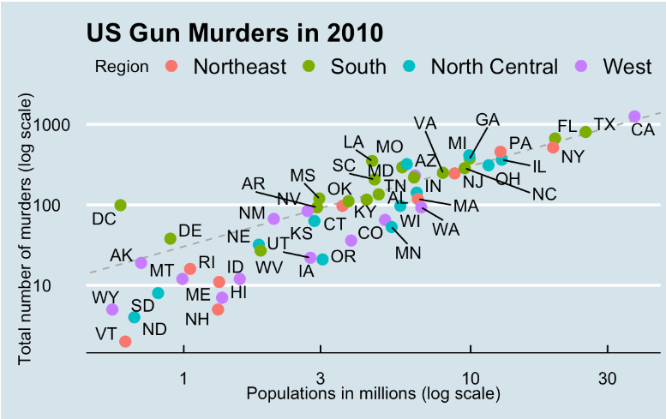
Project analysis slide 11
How powerful can this get?
Base R vs. Tidyverse

Slide 12
Project analysis slide 11
How powerful can this get?
plot(murders$population, murders$rate,xlab="Population",ylab="Murders") title("US Gun Murders in 2010")
Tidyverse:
murders %>% ggplot(aes(population/10^6, total, label = abb)) +
geom_abline(intercept = log10(r), lty = 2, color = "darkgrey") +
geom_point(aes(col=region), size = 3) +
geom_text_repel() +
scale_x_log10() +
scale_y_log10() +
xlab("Populations in millions (log scale)") +
ylab("Total number of murders (log scale)") +
ggtitle("US Gun Murders in 2010") +
scale_color_discrete(name = "Region") +
theme_economist()

Slide 13
Lab time: 1) Stats 2) Visualizations github.com/devaoneil/R

